Slide 1

Green Pace
Security Policy Presentation
Developer: Sarah Sandstrom

Slide 2

OVERVIEW: DEFENSE IN DEPTH

Slide 3
THREATS MATRIX
PROBABILITY | HARM SEVERITY
 | LOW | MEDIUM | HIGH
LIKELY |  |  | STD-005 STD-006 STD-009
PROBABLE | STD-007 |  | STD-002 STD-003 STD-004
UNLIKELY | STD-001 | STD-008 | STD-010

Slide 4
10 PRINCIPLES
Validate Input Data
(STD-001, STD-002, STD-003, STD-004, STD-010)
Head Compiler Warnings
(STD-001, STD-002, STD-005, STD-009)
Architect and Design for Security Policies
(STD-004, STD-007)
Keep it Simple
(STD-001)
Default Deny
Adhere to the Principle of Least Privilege
Sanitize Data Sent to Other Systems
(STD-003, STD-004)
Practice Defense in Depth
(STD-001, STD-002, STD-003, STD-008)
Use of Effective Quality Assurance Techniques
(STD-005, STD-006, STD-007, STD-009, STD-010)
Adopt a Secure Coding Standard
(STD-008)

Slide 5
CODING STANDARDS
Rule | Severity | Likelihood | Remediation Cost | Priority | Level
STD-001 | LOW | UNLIKELY | MEDIUM | LOW | 1
STD-002 | HIGH | PROBABLE | HIGH | HIGH | 5
STD-003 | HIGH | PROBABLE | MEDIUM | HIGH | 4
STD-004 | HIGH | PROBABLE | MEDIUM | HIGH | 5
STD-005 | HIGH | LIKELY | MEDIUM | HIGH | 5
STD-006 | LOW | UNLIKELY | HIGH | MEDIUM | 2
STD-007 | LOW | PROBABLE | MEDIUM | LOW | 3
STD-008 | MEDIUM | UNLIKELY | MEDIUM | LOW | 2
STD-009 | HIGH | LIKELY | MEDIUM | HIGH | 4
STD-010 | HIGH | UNLIKELY | MEDIUM | MEDIUM | 3

Slide 6
ENCRYPTION POLICIES
Encryption in Rest:
How data is stored and held on servers or in repositories
Encryption at Flight:
How the data moves from one computer/device to another
Encryption in Use:
When the data is currently being used

Slide 7
TRIPLE-A POLICIES
Authentication is the process of identifying and verifying a user.
This is handled with user credentials and two factor authentication
Authorization is the process of ensuring a user can do a specified task.
After authentication, a user will have a set of authorizations such as the ability to view certain documents.
Accounting is the practice of logging user statistics and data.
Accounting is used to keep track of modifications and usage statistic , but also monitor and detect intrusions or attacks.

Slide 8
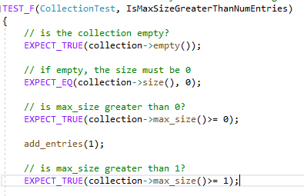
Unit Testing Pt. 1
Verifying the actual size of the vector is less than maximum allowed vector size
Google Test functions:
EXPECT_TRUE &
EXPECT_EQ

Slide 9
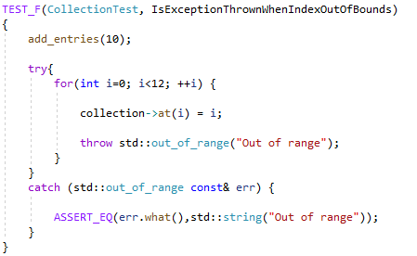
Unit Testing Pt. 2
Verifying that an exception is thrown when know error occurs

Slide 10

AUTOMATION SUMMARY

Slide 11
TOOLS
Build by automating manual processes such as compilation and static code checking. (Tools: Docker, GitLab, or Jenkins)
Verify and Test by automating virtualized container deployment.
Monitor and Detection by automating static application security tests into nightly builds on key sections of code,
Utilize tools like OWASP Dependency Check to check code dependencies and vulnerabilities
Notable Tools: ClangTidy, Cppchecker, Parasoft, Coverity, Jenkins, Gitlab Docker

Slide 12
RISKS AND BENEFITS
Fixing Bugs:
Cost 6 times more to fix a bug found during implementation phase than to fix a bug identified in the design phase
Cost 15 times more to fix a bug during the testing phase than during the design phase

Slide 13
RECOMMENDATIONS
Add more standards
These 10 standards are just the starting foundation
Hire a white hat cyber security firm to test your defenses and find any vulnerabilities

Slide 14
CONCLUSIONS
Start taking the extra step protect your code from the start.
Make sure you fix any issue with your code early on so you can save money and time.
Implement defense in depth
Incorporate daily testing routines into everyday practices

Slide 15
REFERENCES
Mylonas, Leo. “What is AAA Security?”. Codebots. (2018). https://codebots.com/application-security/aaa-security-an-introduction-to-authentication-authorisation-accounting
Ryan. “Encryption in transit and Encryption at-rest”. Rydel. (2019). https://www.ryadel.com/en/data-encryption-in-transit-at-rest-definitions-best-practices-tutorial-guide/
Seacord, Robert. “Top 10 Secure Coding Practices” confluence, (2018). https://wiki.sei.cmu.edu/confluence/display/seccode/Top+10+Secure+Coding+Practices

